Slide 1
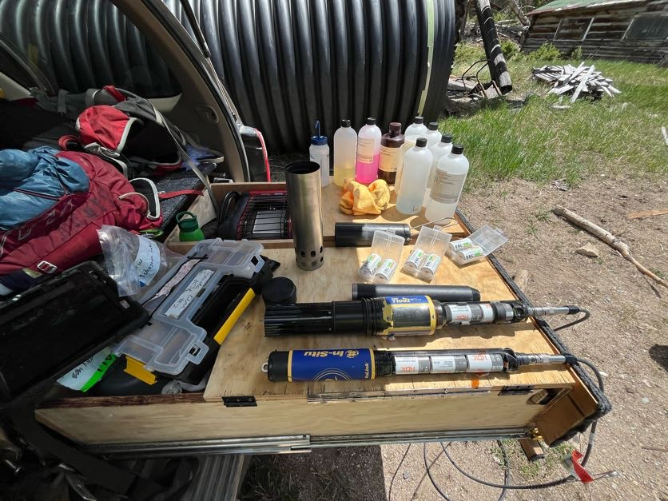
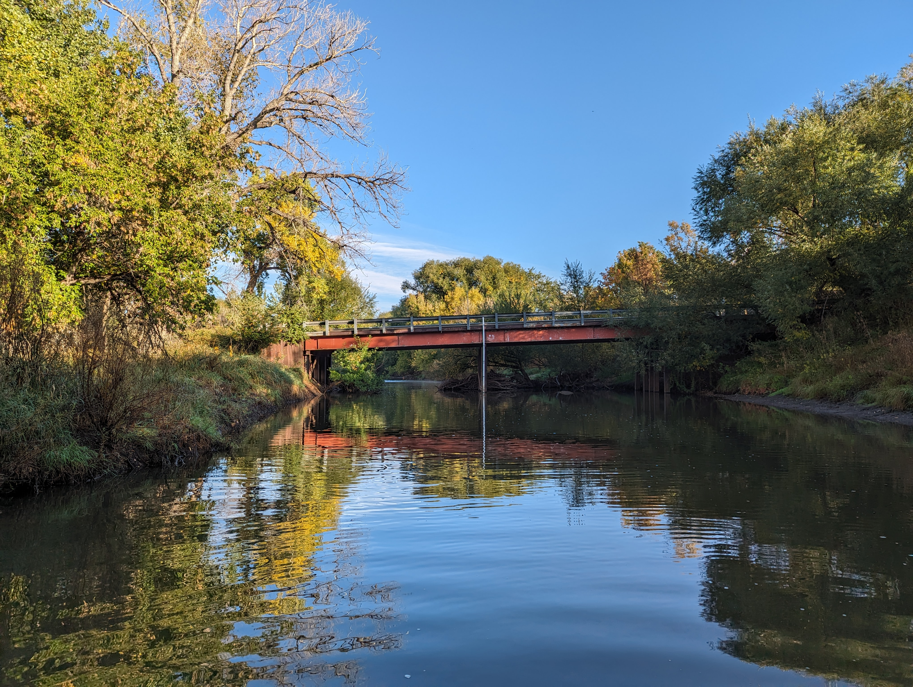
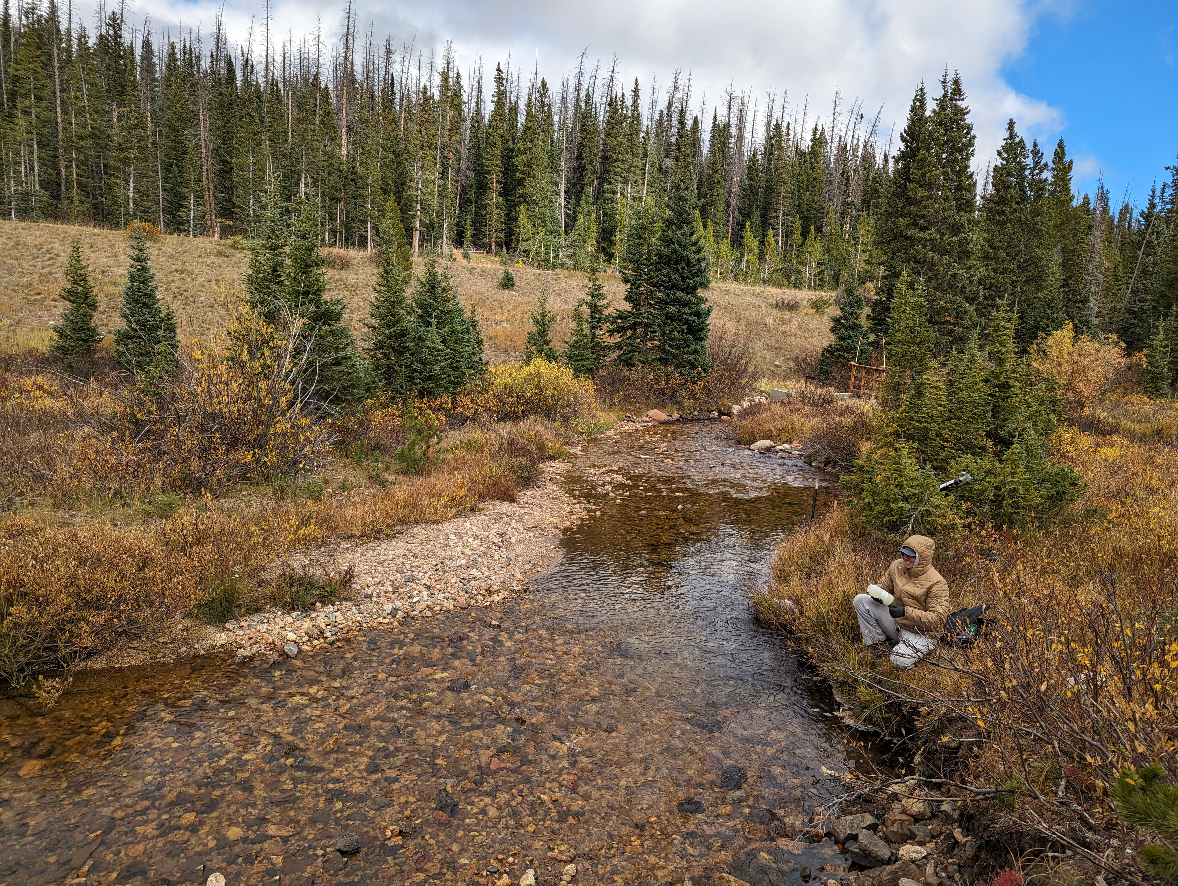
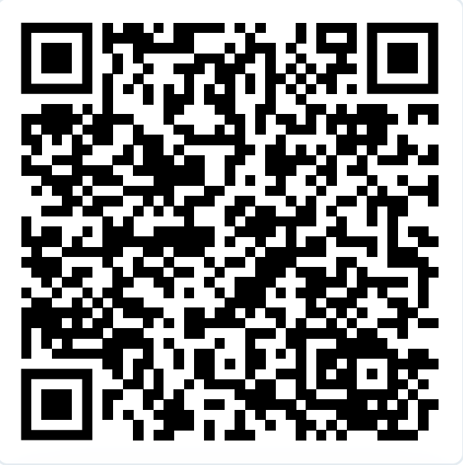
Watershed Science and Water Quality Technician
The ROSS lab is hiring one to two student positions to help maintain water quality sensors and conduct water sampling in the Cache la Poudre River to aid in the long-term planning and water treatment decision support. More details in Handshake posting!
Dates: Mid March – Mid November 2026 (possible extension)
Pay: $18-23 per hour
To apply, see job posting on Handshake: https://colostate.joinhandshake.com/jobs/10763283

